Slide 2

School of Information and Communication Technology
IT3190E – Machine Learning
Stroke Risk Prediction
Supervisor: Assoc. Prof. Than Quang Khoat
Authors:
Nguyen Thanh An 20225541
Pham Tuan Anh 20225542
Le Tien Dat 20225543
Nguyen Quang Hung 20225545
Pham Doan Phuc Lam 20225546
Le Hai Nhat 20225583

Slide 3
Table of Content
Introduction
Dataset
Proposed Models
Bernoulli Naive Bayes
Support Vector Machine
Decision Tree & Random Forest
K-mean Neighbor
Logistic Regression
XGBoost
Results
Conclusion
References

Slide 4
INTRODUCTION

Slide 5
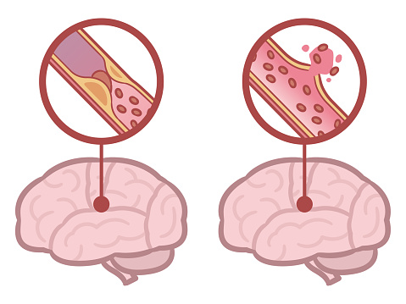
Introduction
Stroke Risk Prediction
Stroke – significant global health concern.
Stroke risk is related to many different factors.
The challenge is to accurately predict stroke risk.
Topic Choice Motivation
Take advantage of advancement in machine learning technique to predict stroke.
Contribution to research on data-driven healthcare solutions.

Slide 6

Introduction
Aim of project:
Develop and evaluate machine learning-based model for stroke risk prediction.
Assist healthcare professional in identifying high-risk individual.
Model used: Naïve Bayes, K-NN, decision tree & random forests, support vector machine (SVM), neutral network and XG-boost.

Slide 7
DATASET

Slide 8
Dataset
Description
Dataset contains 12 attributes with 5104 records
Numerical attributes: id, age, average_glucose_level, bmi
Nominal attributes: gender, hypertension, heart_disease, ever_married, work_type, resisdence_type, smoking_status, stroke
More information: https://www.kaggle.com/datasets/fedesoriano/stroke-prediction-dataset

Slide 9
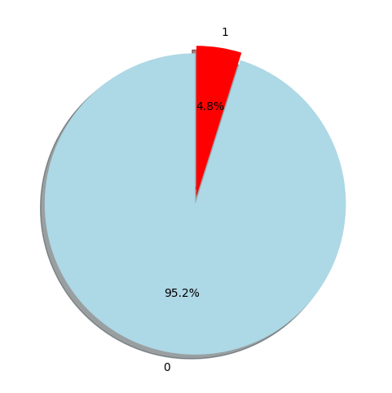
Dataset
We can see that the data is imbalance!

Slide 10
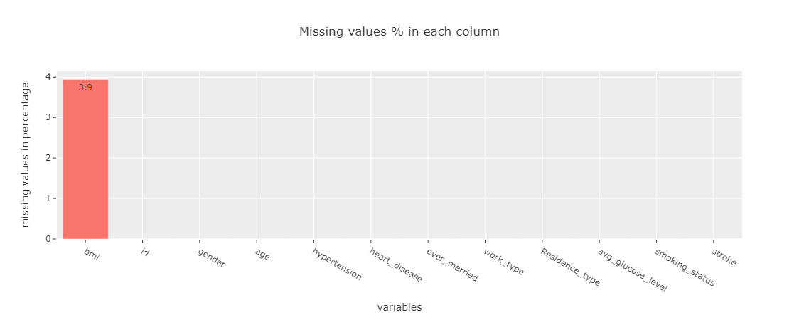
Dataset

Slide 11
Dataset
Data Analysis and Preprocessing
The “id” attribute is unnecessary ➔ Drop “id” column
The “bmi” attribute has some NaN value
➔ Replacing by mean value of “bmi”
In the dataset, only 4.8% patient had stroke. So that this data is highly unbalanced.
➔ Handling unbalanced dataset by “Synthetic Minority Oversampling Technique” (SMOTE)

Slide 12
PROPOSED MODELS

Slide 13


BERNOULLI NAIVE BAYES
Parameters: $alpha ∈\left\{1.0, 1.25, 1.5, 1.75, 2.0\right\}$
$binarize ∈\{0.0, 0.25, 0.5, 0.75, 1.0\}$
Results:
Accuracy | 75.78%
Precision | 72.14%
Recall | 83.81%
F1 score | 77.54%
Accuracy | 76.04%
Precision | 72.26%
Recall | 84.33%
F1 score | 77.83%
Default parameters
$$alpha=1, binarize=0.5$$

Slide 14

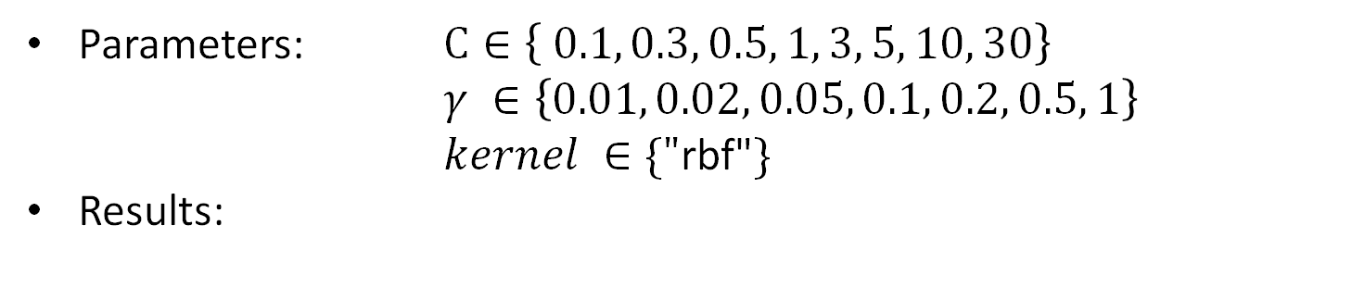
SUPPORT VECTOR MACHINE
Parameters: $C∈\left\{ 0.1, 0.3, 0.5, 1, 3, 5, 10, 30\right\}$
$γ ∈\left\{0.01, 0.02, 0.05, 0.1, 0.2, 0.5, 1\right\}$
$kernel ∈\{"\text{rbf}\text{"}\}$
Results:
Accuracy | 76.45%
Precision | 74.06%
Recall | 82.06%
F1 Score | 77.85%
Accuracy | 95.78%
Precision | 96.19%
Recall | 95.40%
F1 Score | 95.79%
Default parameters
C = 3.0, $γ=$0.2

Slide 15
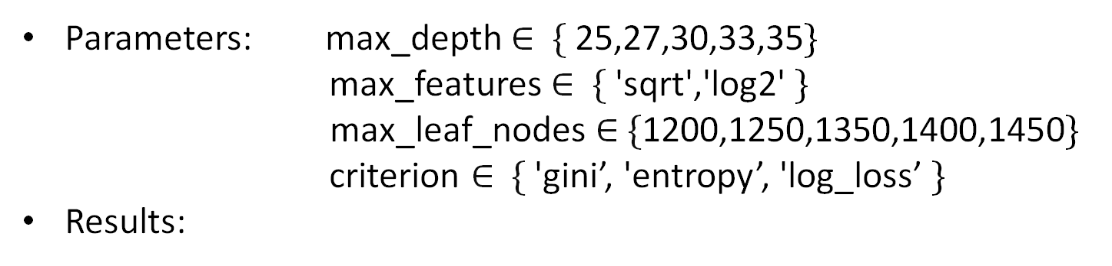
DECISION TREE
Parameters: max_depth ∈ $\{$25,27,30,33,35$\}$
max_features ∈ $\{$'sqrt','log2' $\}$ max_leaf_nodes ∈ $\{$1200,1250,1350,1400,1450$\}$
criterion ∈ $\{$'gini’, 'entropy’, 'log_loss’ $\}$
Results:
Accuracy | 91.20%
Precision | 90.57%
Recall | 92.14%
F1 score | 91.35%
Accuracy | 91.10%
Precision | 89.80%
Recall | 92.94%
F1 score | 91.29%
Default parameters
criterion = “entropy”,
max_depth = 30,
max_features = “sqrt”
max_leaf_nodes = 1450

Slide 16
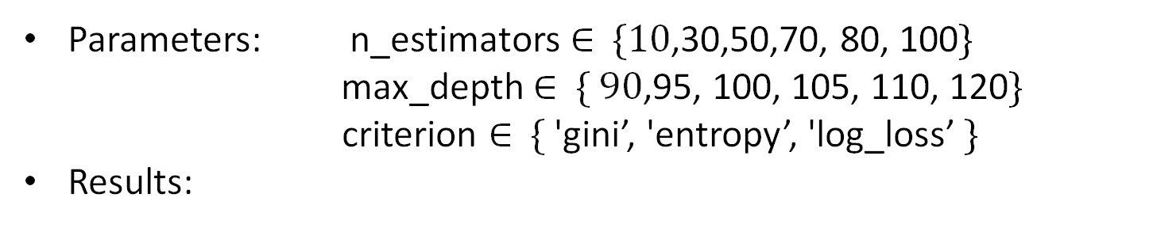
RANDOM FOREST
Parameters: n_estimators ∈ $\{10$,30,50,70, 80, 100$\}$
max_depth ∈ $\{ 90$,95, 100, 105, 110, 120$\}$ criterion ∈ $\{$'gini’, 'entropy’, 'log_loss’ $\}$
Results:
Accuracy | 95.06%
Precision | 94.07%
Recall | 96.20%
F1 score | 95.12%
Accuracy | 93.57%
Precision | 92.57%
Recall | 94.96%
F1 score | 93.65%
Default parameters
critertion = “gini”,
max_depth = 105,
n_estimators = 70

Slide 17

K-NEAREST NEIGHBOR
Parameters: neighbors $∈[1, 30]$
metric $∈$ $\{$“euclidean”, “manhattan”, “cosine” $\}$
weight$∈$ $\{$“uniform”, “distance”$\}$
Results:
Accuracy | 92.21%
Precision | 91.56%
Recall | 92.84%
F1 score | 92.20%
Accuracy | 92.86%
Precision | 92.01%
Recall | 93.67%
F1 score | 92.83%
neighbors = 2
neighbors = 2, metric = “manhattan”,
weights = “uniform”

Slide 18
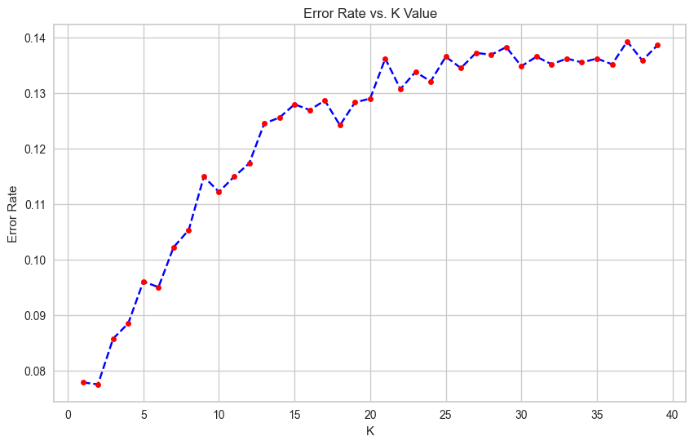
K-NEAREST NEIGHBOR

Slide 19

LOGISTIC REGRESSION
Parameters: solver $∈${ “lbfgs”, “liblinear” $\}$
max_iter $∈\{100, 200, 300, 400, 500\}$
multi_class $∈$ $\{$“auto”, “ovr”, “multinomial”$\}$
penalty$∈$ $\{$“l1”, “l2”, “elasticnet”, “none”$\}$
Results:
Accuracy | 76.89%
Precision | 76.26%
Recall | 78.82%
F1 score | 77.52%
Accuracy | 75.76%
Precision | 75.58%
Recall | 76.88%
F1 score | 76.22%
Default parameters
solver = “lbfgs”, max_iter = 200, multi_class = “auto”, penalty = “l2”

Slide 20

XGBOOST
Parameters: n_estimators $∈\{100, 500, 1000\}$
learning_rate $∈\{0.01, 0.1, 0.5\}$
booster $∈\{$ “gbtree”, “gblinear”$\}$
gamma $∈ \{0, 0.5, 1.0\}$
reg_lamda $∈\{0, 0.5, 1.0\}$
Results:
Accuracy | 94.49%
Precision | 92.75%
Recall | 96.63%
F1 score | 94.65%
Accuracy | 95.57%
Precision | 95.00%
Recall | 96.18%
F1 score | 95.59%
Default parameters
n_estimater = 100, learning_rate = 0.1, booster = “gbtree”, gamma = 0, reg_lamda = 0

Slide 21
RESULTS

Slide 22
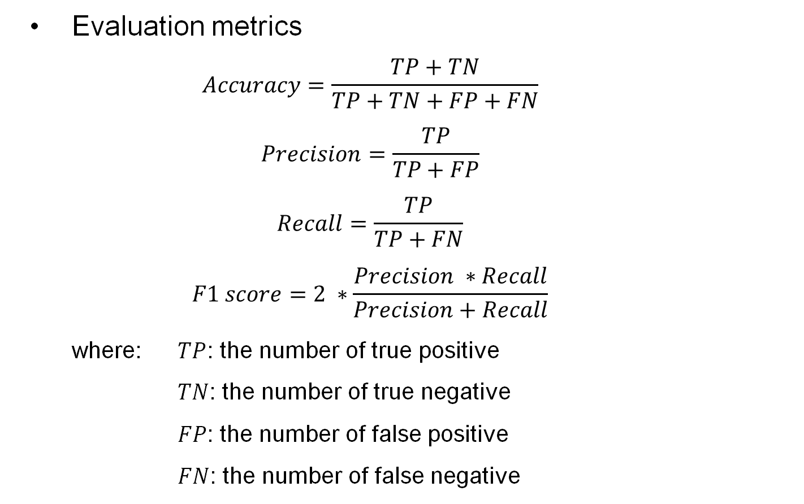
Results
Evaluation metrics
$$Accuracy=\frac{TP+TN}{TP+TN+FP+FN}$$
$$Precision=\frac{TP}{TP+FP}$$
$$Recall=\frac{TP}{TP+FN}$$
$$F1 score=2 ∗\frac{Precision ∗Recall}{Precision+Recall}$$
where: $TP$: the number of true positive
$TN$: the number of true negative
$FP$: the number of false positive
$FN$: the number of false negative

Slide 23
Results
Compare results
 | Accuracy | Precision | Recall | F1
Naive Bayes | 76.04% | 72.26% | 84.33% | 77.83%
SVM (Gaussian) | 95.78% | 96.19% | 95.40% | 95.79%
Decision Tree | 91.20% | 90.57% | 92.14% | 91.35%
Random Forest | 95.06% | 94.07% | 96.20% | 95.12%
KNN Classifier | 92.86% | 92.01% | 93.67% | 92.83%
Logistic Regression | 75.76% | 75.58% | 76.88% | 76.22%
XGBoost | 95.57% | 95.00% | 96.18% | 95.59%
Performance of different models

Slide 24
CONCLUSIONS

Slide 25

Conclusion
This project explores the use of ML to predict stroke occurrence by evaluating various machine learning algorithms, focusing on features relevant to participants' profiles.
The findings reveal that Support Vector Machine with a Gaussian kernel is the most effective, achieving an F1-score of 95.79% and an accuracy of 95.78%, making it a powerful tool for long-term stroke risk prediction.

Slide 26
References
[1] “Stroke.” (), [Online]. Available: https://en.wikipedia.org/wiki/Stroke.
[2] fedesoriano. “Stroke prediction dataset.” (), [Online]. Available: https://www.kaggle.com/datasets/ fedesoriano/stroke-prediction-dataset. (accessed: 22.05.2024).
[3] “Smote.” (), [Online]. Available: https://imbalanced-learn.org/stable/references/generated/ imblearn.over_sampling.SMOTE.html. (accessed: 22.05.2024).
[4] “Random forest algorithm in machine learning.” (), [Online]. Available: https://www.geeksforgeeks. org/random-forest-algorithm-in-machine-learning/. (accessed: 22.05.2024).
[5] “Xgboost.” (), [Online]. Available: https://www.geeksforgeeks.org/xgboost/. (accessed: 22.05.2024).
[6] “Evaluation metrics.” (), [Online]. Available: https://www.analyticsvidhya.com/blog/2019/ 08/11-important-model-evaluation-error-metrics/#:~:text=of%20machine%20learning.- ,What%20Are%20Evaluation%20Metrics%3F,comparing%20different%20models%20or%20algorithms.. 23

Slide 27
THANK YOU FOR YOUR ATTENTION!

